Slide 1
JAVA PROJECT BATCH
GUI Programming
Lecture 3

Slide 2
Table Of Contents
01.
Event Handling in Java
02.
Event, Event Source and Event Listeners
03.
Listener interfaces
04.
Exercise

Slide 3


Event Handling
• Every GUI application allows its users to interact with it through various devices like mouse, keyboard, touchpen etc.
• When the user performs any action using any of these devices then that action is called an EVENT.
For example:
1. Clicking on a button
2. Moving the mouse
3. Typing some text into a text field

Slide 4
Event Handling
• As soon as an event occurs the application should respond accordingly.
Any such response by an application is programmed by a programmer and is known as
EVENT HANDLING.
For example:
When an user clicks on play button in the media player the song starts playing, the user drags volume control and accordingly volume changes.

Slide 5
Java’s Model Of Event Handling
• To understand event handling in Java, we need to understand 3 important terminologies:
Event:- Any action performed by the user on the application is an event.
Examples: clicking a button, dragging mouse, typing through a keyboard etc.
Event Source:- Event Sources are those GUI Components whose interaction
with the user causes something to happen.
Examples: button, text field, frame etc.

Slide 6
Event Handling
Event Listener:-
As soon as an event occurs, Java automatically invokes a specific method.
So, the programmer can define or to be specific , can override these methods in his own class.
Such classes and their objects whose methods are invoked by Java on any action
performed by the user are called Event Listeners.

Slide 7
Event Handling
For example:
Whenever the user clicks a button, then Java automatically calls a method called
actionPerformed().
This method is available in an interface called ActionListener.
So, the class which inherits this interface and overrides the method actionPerformed() will
be called as EVENT LISTENER.
A method which is invoked by Java automatically is known as CALL BACK.

Slide 8
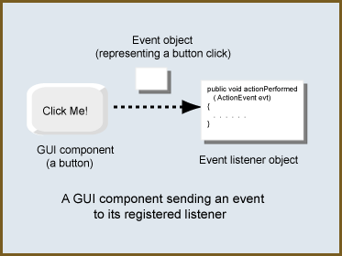
Event Handling

Slide 9
Exercise
• Design a Frame which contains a button titled Close App and whenever the user
clicks on it, the application should close.

Slide 10
Solution
package sca.gui.awt.examples;
import java.awt.Button;
import java.awt.Color;
import java.awt.FlowLayout;
import java.awt.Frame;
import java.awt.event.ActionEvent;
import java.awt.event.ActionListener;
class MyButtonFrame2 extends Frame
{
Button b;
public MyButtonFrame2()
{
setTitle("Sachin's Frame");
setSize(400,400);

Slide 11
Solution
setLocation(200,200);
setVisible(true);
setBackground(Color.yellow);
b=new Button("Close App");
FlowLayout fl=new FlowLayout();
setLayout(fl);
add(b);
CloseFrame cf=new CloseFrame();
b.addActionListener(cf);
}
}
Event ListenerObject
Event source object

Slide 12
Solution
class CloseFrame implements ActionListener
{
@Override
public void actionPerformed(ActionEvent e)
{
System.exit(0);
}
}
Name of the Event
interface

Slide 13
Solution
public class Example5 {
public static void main(String[] args) {
MyButtonFrame2 fr=new MyButtonFrame2();
}
}

Slide 14
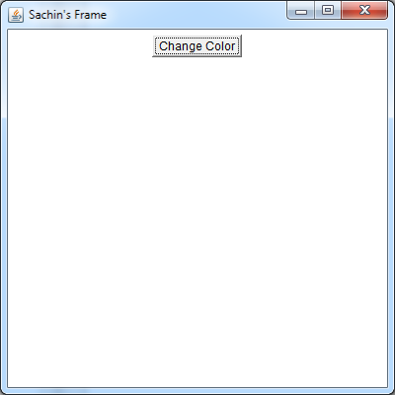
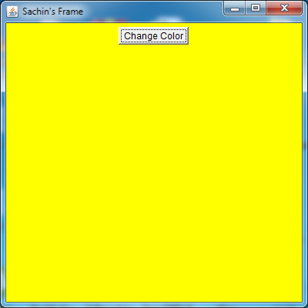
Assignment
• Design a Frame which contains a button titled Change Color and whenever the
user clicks on it, the background color of the Frame should become Yellow.
Originally the Frame should have White background color.
After Clicking

Slide 15


